Slide 1
Province of Yorkshire, West Riding
Treasurers’
Workshop 2017

Slide 2
Introduction
Lodge Treasurer’s Duties
Income & Expenditure Account & Balance Sheet
Records & Responsibilities
Audit Requirement
Budgets

Slide 3
Treasurer’s Duties
Governed by:
Book of Constitutions
Provincial Grand Lodge / Chapter requirements
Financial Stewardship

Slide 4
Book of Constitutions - Rule 153
Receive all monies due
Deposit receipts in an account in the name of the Lodge / Chapter and approved by resolution of Lodge / Chapter
Make duly authorised payments without delay
Cheques to be signed by at least two members authorised by name by resolution of the Lodge / Chapter
Both cheque signatories to be satisfied amount is due
One of the signatories on every cheque should be the Treasurer unless it is impracticable
Electronic payments can be made by Treasurer alone but only after authorisation by resolution of the Lodge / Chapter
Keep proper books of account
Prepare a statement of accounts annually
Have accounts audited by the Audit Committee
Present the accounts in Open Lodge for approval

Slide 5
Book of Constitutions – Rule 153
Other Funds
Charity Benevolent Alms Dining Social Bar
Same procedure for annual accounts audit and presentation to members
Whether maintained by Treasurer or Another Member
Not obligatory for Treasurer to be signatory or keep the books of account for such funds
Bank and account signatories must still be approved by resolution of Lodge / Chapter

Slide 6
PGL / PGC Requirements
Lodge / Chapter accounts must be maintained and presented to Lodge / Chapter Members in accordance with Rule 153 Book of Constitutions
Copy of accounts and Audit Committee’s certificate must be sent to Provincial Grand Secretary / Scribe E with summons for meeting at which they are to be presented

Slide 7
Financial Stewardship
Should have regard to:
Lodge / Chapter By- laws
Duty of care to brethren/companions
Requirements of members (expressed in Open Lodge / Chapter)

Slide 8
Financial Stewardship . . .
Includes:
Preparing budget & ensuring Subscriptions are adequate
Ensuring Subscriptions are received on time
Reporting non-payment of Subscriptions to Lodge/Chapter Committee
Ensuring Dining Fees are adequate to cover cost of meals
Ensuring Insurance in place for Lodge/Chapter assets
Ensuring Surplus Funds invested appropriately
Ensuring all Expenditure is duly authorised

Slide 9
Income & Expenditure Account & Balance Sheet
Specimen formats in Handout
Formats not prescriptive
Income & Expenditure Account should be prepared on Accruals basis

Slide 10
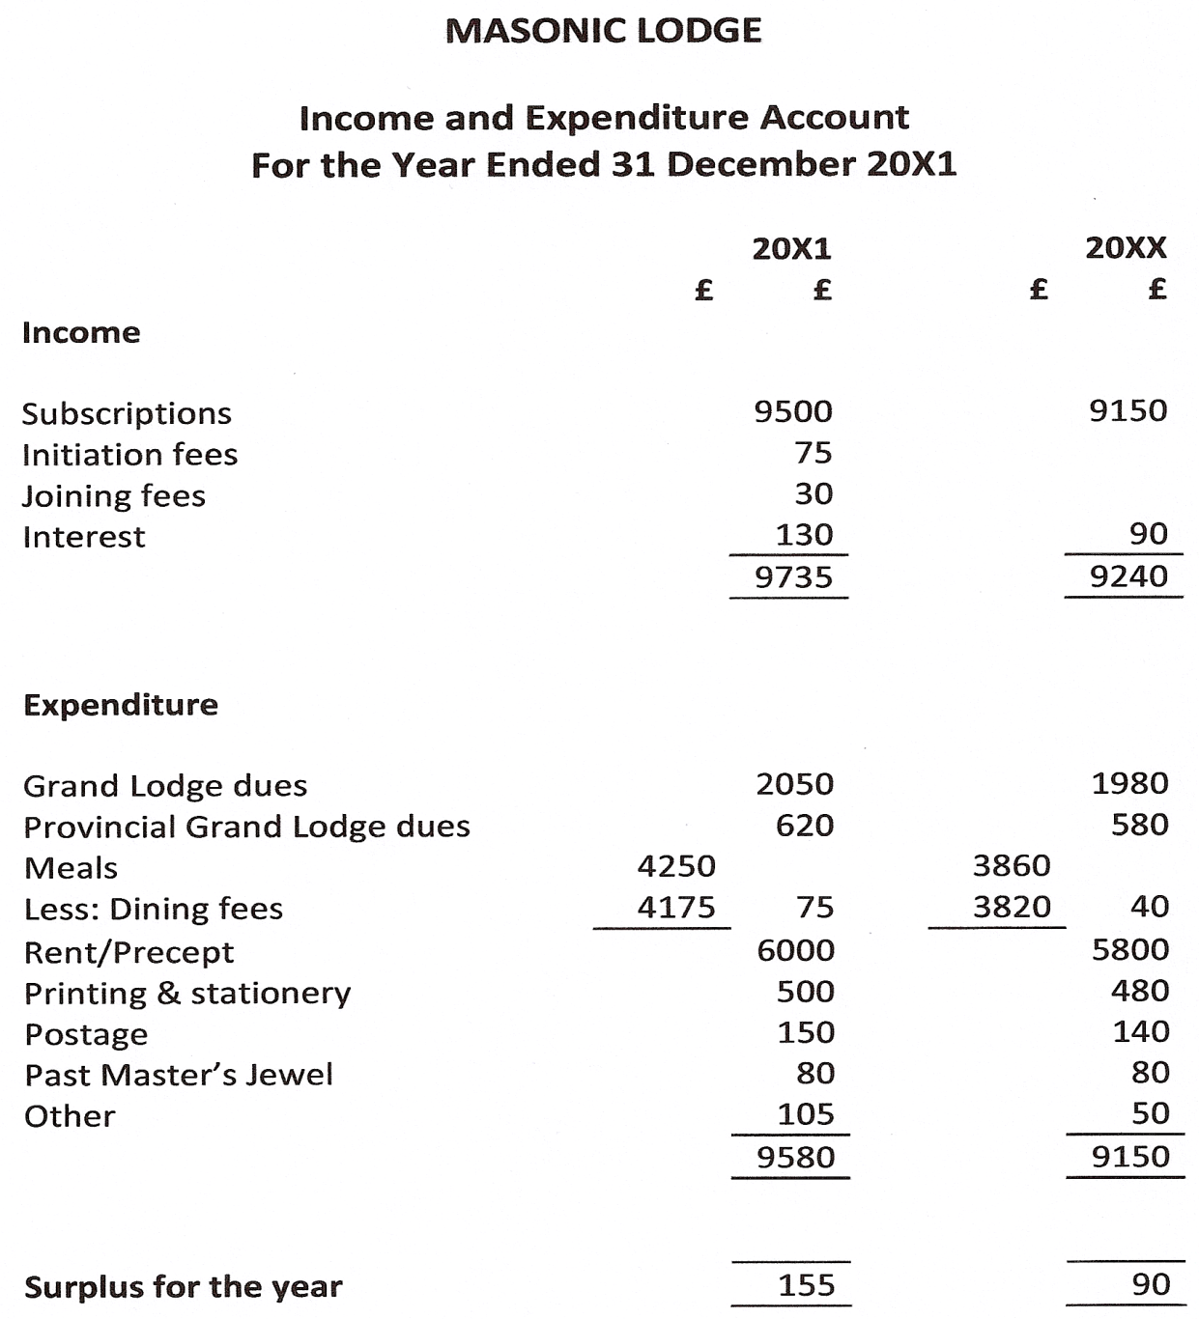

Slide 11
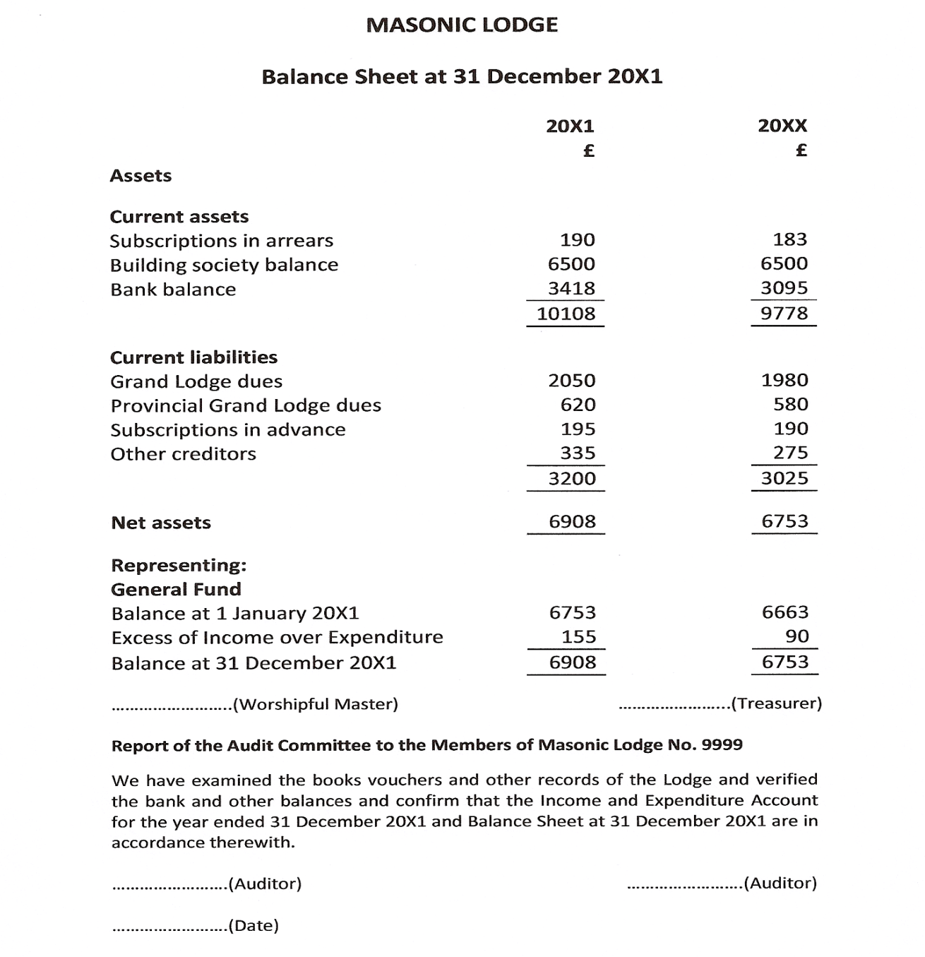

Slide 12
Sources of information for preparation of accounts
Opening balance sheet
Cash book transactions
Adjustments including prepayments & accruals
Subscriptions
Grand & Provincial Grand Lodge Dues
Expenses

Slide 13
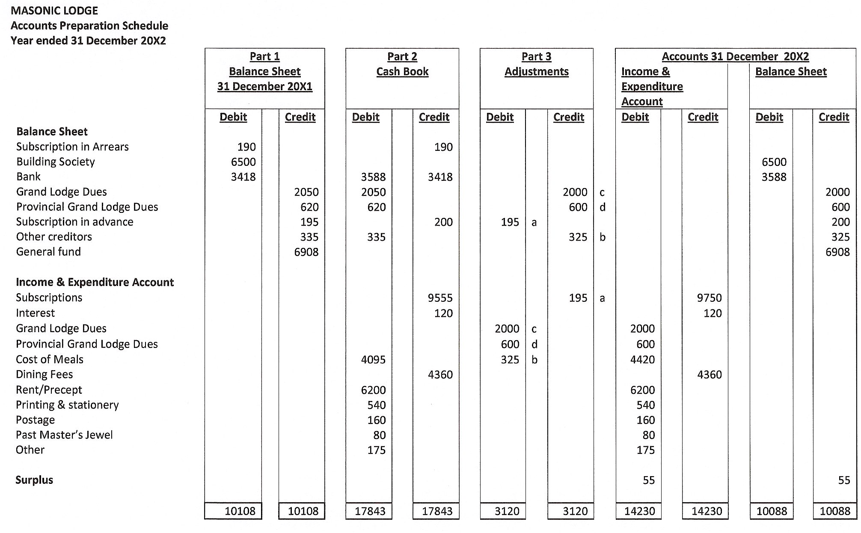

Slide 14
Records & Responsibilities
Cash Book
Lodge / Chapter Funds
Members Subscription Record
Lodge / Chapter Investments & Properties
Lodge / Chapter Inventory
Taxation

Slide 15
Cash book
Computerised spreadsheet or Manual
Columnar to provide analysis of receipts & payments
Regular reconciliation with bank statement
Records are the property of the Lodge / Chapter

Slide 16
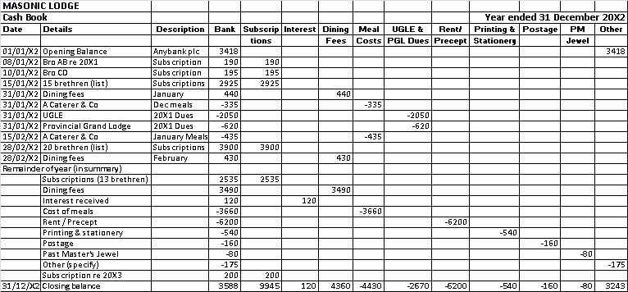

Slide 17
Lodge / Chapter Funds
All moneys to be paid into a Bank Account
Account to be in Lodge / Chapter name
Surplus funds to be placed on deposit
All receipts to be paid into the bank
All payments to be paid by cheque
Receipts to be issued for income if appropriate
Invoices or receipts to be obtained for payments made

Slide 18
Members Subscription Record
Bound book or annual list
Record for each Subscribing Member
Amount due
Amount received
Date received
Total amount received to agree to cash book

Slide 19
Lodge / Chapter Investments & Properties
Obtain advice from reputable financial advisor
Security of funds is paramount
Investments to be held in name of Lodge or Chapter (or trustees)
Trustees of Masonic Halls or Shares in Masonic Hall Companies
Safe keeping of documents of title

Slide 20
Lodge / Chapter Inventory
Maintain inventory of lodge property
Shared items
Unusual or valuable items
Ensure insurance cover is in place

Slide 21
Taxation
Lodges & Chapters are within scope of Corporation Tax
Investment Income, Rents & Capital Gains
are taxable
Subscription Income is not taxable
Lodge running costs are not deductible

Slide 22
Taxation . . .
Legal requirement to file a Corporation Tax return
£10,000 zero rate band in force from 2002 to 2006 – no liability for most Lodges/Chapters
Zero rate band withdrawn from April 2006 – all lodges / chapters now potentially taxable
But no liability and no return required if tax would be less than £100
Returns must now be filed electronically
IF IN DOUBT OBTAIN PROFESSIONAL ADVICE

Slide 23
Bank & Building Society Interest
Any tax deducted can be offset or reclaimed
May prefer to have interest paid gross
Banks should pay gross automatically
Building Societies may require Form 38(INP)

Slide 24
Audit Requirements
Audit Committee
Scope of the Audit
Audit Report
Audited Accounts
Other Lodge Funds

Slide 25
Audit Committee
To be elected annually (Rule 153)
Senior members of the Lodge / Chapter
Not actively involved in handling funds

Slide 26
Scope of the Audit
Check accuracy of Accounts
Ensure Accounts in agreement with books and records
Agree balances to statements / certificates

Slide 27
Audit Report
Appended to Accounts
Signed by Audit Committee
Confirm carried out responsibilities per Rule 153
See Example

Slide 28
Audited Accounts
Copy to be sent to all Lodge / Chapter members with summons for meeting at which they are to be considered
To be approved in Open Lodge / Chapter
To be approved no later than third meeting after balance sheet date
Earlier deadline may apply
Master, Treasurer & Auditors should not propose adoption

Slide 29
Other Lodge / Chapter Funds
Charity Benevolent Alms Dining Social Bar etc
Same principles apply for:
Control of Funds
Annual Accounts
Audit
Presentation to Members
Submitting accounts to Province (Charity Benevolent Alms)
Masonic Hall Committees / Companies

Slide 30
Budget
Prepare before proposing Lodge / Chapter subscription
Base on anticipated expenditure
Discuss with Lodge / Chapter Committee
Obtain Committee approval for budget & subscription
Monitor actual income & expenditure against budget during year
Report significant variances to committee

Slide 31
Guidance on Financial Matters
Alms Collections
Raffles
Lodge Social Functions
Lodge Festive Boards
Charity
Lodge Trustees
Masonic Halls

Slide 32
And finally, thank you for listening – ANY QUESTIONS?. Treasurers’ Workshop Province of Yorkshire, West Riding

